Slide 1
AWS Cloud Map
Prepared by : Anand

Slide 2
What is Cloud Map ?
Cloud resource discovery service
Enables you to name your application resources with custom names, and it automatically updates the locations of these dynamically changing resources
This increases your application availability because your applications always discover the most up-to-date locations of its resources

Slide 3
Why Cloud Map?
Cloud Map allows you to register any application resources such as databases, queues, microservices, and other cloud resources with custom names
Cloud Map then constantly checks the health of resources to make sure the location is up-to-date
Route-53 automates service name management in DNS and supported IP-based resources only. AWS Cloud Map extends the capabilities of the Auto Naming APIs by providing a service registry for resources, represented by IPs, URLs, and ARNs and offering an API-based service discovery mechanism

Slide 4

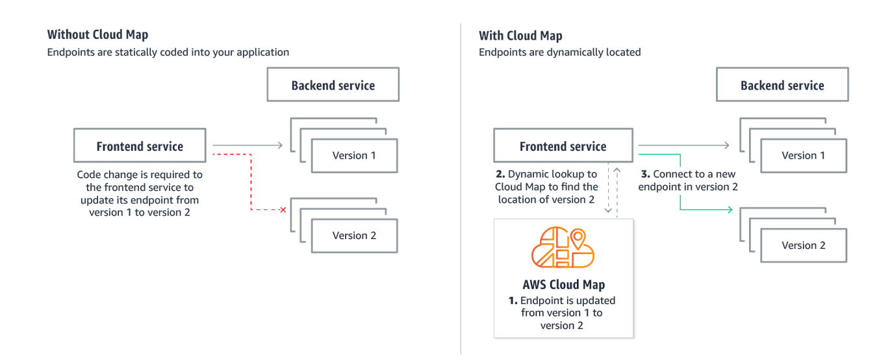



How AWS Cloud Map Works?

Slide 5
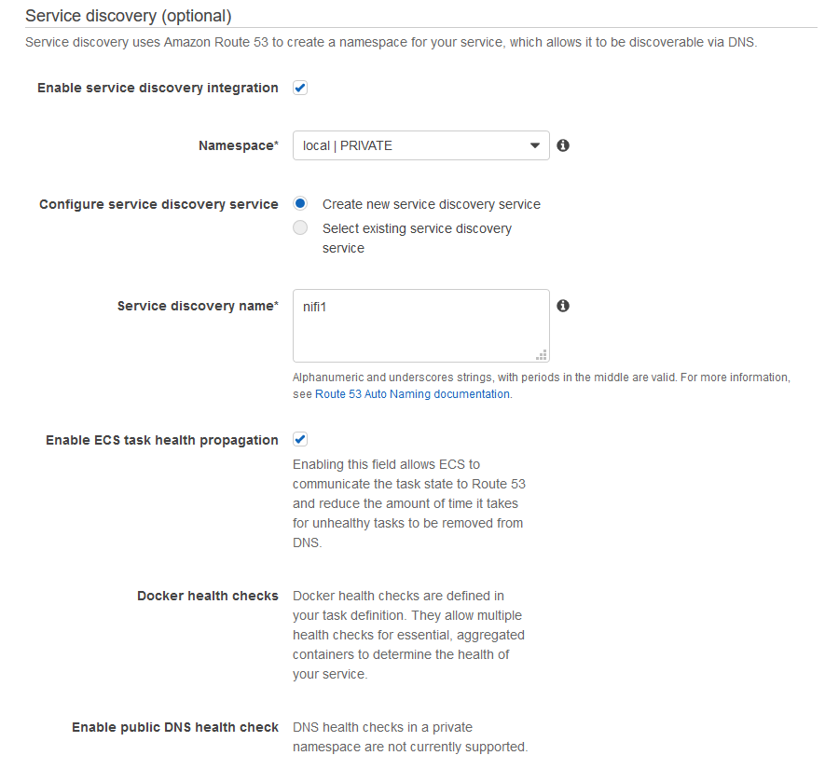
Integration with ECS
When you create an ECS service, you can choose to enable service discovery by specifying a custom name, attributes, and optional health-checking settings for the service. As ECS launches tasks for your service, it registers them as resources in the AWS Cloud Map service registry, which ensures that the tasks become discoverable via API calls and DNS queries.

